Slide 1
Intercultural Communication
Presented by Team B

Slide 2
Values and Beliefs
1
Fate
PPT模板：www.1ppt.com/moban/ PPT素材：www.1ppt.com/sucai/
PPT背景：www.1ppt.com/beijing/ PPT图表：www.1ppt.com/tubiao/
PPT下载：www.1ppt.com/xiazai/ PPT教程： www.1ppt.com/powerpoint/
资料下载：www.1ppt.com/ziliao/ 范文下载：www.1ppt.com/fanwen/
试卷下载：www.1ppt.com/shiti/ 教案下载：www.1ppt.com/jiaoan/
PPT论坛：www.1ppt.cn PPT课件：www.1ppt.com/kejian/
语文课件：www.1ppt.com/kejian/yuwen/ 数学课件：www.1ppt.com/kejian/shuxue/
英语课件：www.1ppt.com/kejian/yingyu/ 美术课件：www.1ppt.com/kejian/meishu/
科学课件：www.1ppt.com/kejian/kexue/ 物理课件：www.1ppt.com/kejian/wuli/
化学课件：www.1ppt.com/kejian/huaxue/ 生物课件：www.1ppt.com/kejian/shengwu/
地理课件：www.1ppt.com/kejian/dili/ 历史课件：www.1ppt.com/kejian/lishi/
2
Gender Roles
3
Communities
4
Power
Notes:
Spanish

Slide 3
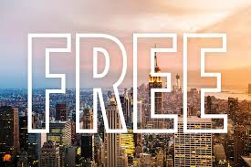
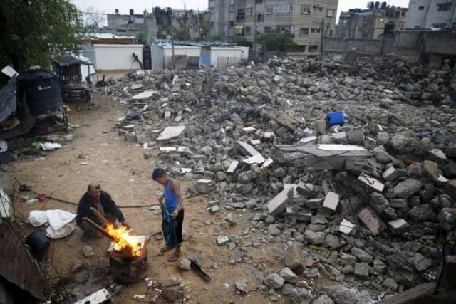
Fate
America
Palestine
The American Dream
Destiny is in their hands
Contested lands
Life is predestined

Slide 4
Beliefs and Values
1
Fate
PPT模板：www.1ppt.com/moban/ PPT素材：www.1ppt.com/sucai/
PPT背景：www.1ppt.com/beijing/ PPT图表：www.1ppt.com/tubiao/
PPT下载：www.1ppt.com/xiazai/ PPT教程： www.1ppt.com/powerpoint/
资料下载：www.1ppt.com/ziliao/ 范文下载：www.1ppt.com/fanwen/
试卷下载：www.1ppt.com/shiti/ 教案下载：www.1ppt.com/jiaoan/
PPT论坛：www.1ppt.cn PPT课件：www.1ppt.com/kejian/
语文课件：www.1ppt.com/kejian/yuwen/ 数学课件：www.1ppt.com/kejian/shuxue/
英语课件：www.1ppt.com/kejian/yingyu/ 美术课件：www.1ppt.com/kejian/meishu/
科学课件：www.1ppt.com/kejian/kexue/ 物理课件：www.1ppt.com/kejian/wuli/
化学课件：www.1ppt.com/kejian/huaxue/ 生物课件：www.1ppt.com/kejian/shengwu/
地理课件：www.1ppt.com/kejian/dili/ 历史课件：www.1ppt.com/kejian/lishi/
2
Gender Roles
3
Communities
4
Power
Notes:
Spanish

Slide 5
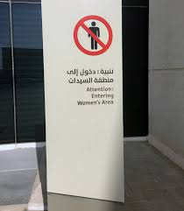
Gender Roles
Most countries today view men and women as equal
There are a few exceptions:
e.g. Saudi Arabia
Ranked 141st out of 144 countries for gender parity (World Economic Forum)
Segregation
Male guardians

Slide 6
Beliefs and Values
1
Fate
PPT模板：www.1ppt.com/moban/ PPT素材：www.1ppt.com/sucai/
PPT背景：www.1ppt.com/beijing/ PPT图表：www.1ppt.com/tubiao/
PPT下载：www.1ppt.com/xiazai/ PPT教程： www.1ppt.com/powerpoint/
资料下载：www.1ppt.com/ziliao/ 范文下载：www.1ppt.com/fanwen/
试卷下载：www.1ppt.com/shiti/ 教案下载：www.1ppt.com/jiaoan/
PPT论坛：www.1ppt.cn PPT课件：www.1ppt.com/kejian/
语文课件：www.1ppt.com/kejian/yuwen/ 数学课件：www.1ppt.com/kejian/shuxue/
英语课件：www.1ppt.com/kejian/yingyu/ 美术课件：www.1ppt.com/kejian/meishu/
科学课件：www.1ppt.com/kejian/kexue/ 物理课件：www.1ppt.com/kejian/wuli/
化学课件：www.1ppt.com/kejian/huaxue/ 生物课件：www.1ppt.com/kejian/shengwu/
地理课件：www.1ppt.com/kejian/dili/ 历史课件：www.1ppt.com/kejian/lishi/
2
Gender Roles
3
Communities
4
Power
Notes:
Spanish

Slide 7
Communities in different cultures
Individualism
Communitarianism
Individual first
E.g. US
Works and achieves alone
Quick to iron out issues and stand up for himself/herself
Community first
E.g. Japan
Direct confrontation is avoided
Decisions are made collectively

Slide 8
Beliefs and Values
1
Fate
PPT模板：www.1ppt.com/moban/ PPT素材：www.1ppt.com/sucai/
PPT背景：www.1ppt.com/beijing/ PPT图表：www.1ppt.com/tubiao/
PPT下载：www.1ppt.com/xiazai/ PPT教程： www.1ppt.com/powerpoint/
资料下载：www.1ppt.com/ziliao/ 范文下载：www.1ppt.com/fanwen/
试卷下载：www.1ppt.com/shiti/ 教案下载：www.1ppt.com/jiaoan/
PPT论坛：www.1ppt.cn PPT课件：www.1ppt.com/kejian/
语文课件：www.1ppt.com/kejian/yuwen/ 数学课件：www.1ppt.com/kejian/shuxue/
英语课件：www.1ppt.com/kejian/yingyu/ 美术课件：www.1ppt.com/kejian/meishu/
科学课件：www.1ppt.com/kejian/kexue/ 物理课件：www.1ppt.com/kejian/wuli/
化学课件：www.1ppt.com/kejian/huaxue/ 生物课件：www.1ppt.com/kejian/shengwu/
地理课件：www.1ppt.com/kejian/dili/ 历史课件：www.1ppt.com/kejian/lishi/
2
Communities
3
Gender Roles
4
Power
Notes:
Spanish

Slide 9
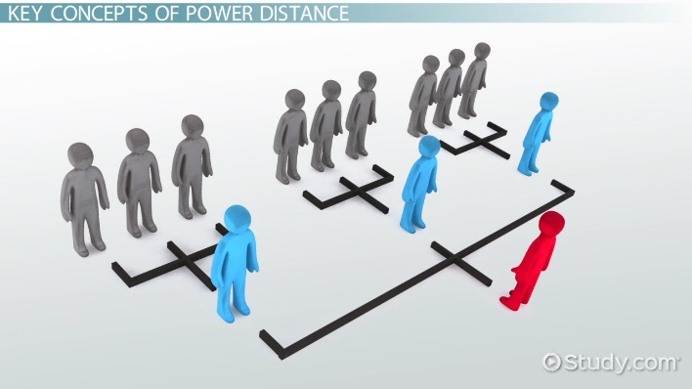
Power
Viewed differently
Some cultures separate wealth, status and power
E.g. US
Interpreted differently
Hofstede’s Power Distance Index
Lower = More democratic relationships
Higher = More authoritative relationships

Slide 10
Language Barrier

Slide 11
MAIN CONTENTS
1
Language Barrier in talking
PPT模板：www.1ppt.com/moban/ PPT素材：www.1ppt.com/sucai/
PPT背景：www.1ppt.com/beijing/ PPT图表：www.1ppt.com/tubiao/
PPT下载：www.1ppt.com/xiazai/ PPT教程： www.1ppt.com/powerpoint/
资料下载：www.1ppt.com/ziliao/ 范文下载：www.1ppt.com/fanwen/
试卷下载：www.1ppt.com/shiti/ 教案下载：www.1ppt.com/jiaoan/
PPT论坛：www.1ppt.cn PPT课件：www.1ppt.com/kejian/
语文课件：www.1ppt.com/kejian/yuwen/ 数学课件：www.1ppt.com/kejian/shuxue/
英语课件：www.1ppt.com/kejian/yingyu/ 美术课件：www.1ppt.com/kejian/meishu/
科学课件：www.1ppt.com/kejian/kexue/ 物理课件：www.1ppt.com/kejian/wuli/
化学课件：www.1ppt.com/kejian/huaxue/ 生物课件：www.1ppt.com/kejian/shengwu/
地理课件：www.1ppt.com/kejian/dili/ 历史课件：www.1ppt.com/kejian/lishi/
Accent & Underlying meaning
2
Language Barrier in writing
Translation
Notes:
Spanish

Slide 12
Neì gē
“Nigger”
那个
Ennnn Ahhhh
(What am I going say?)

Slide 13
No & Now
A Spanish Bungee Jumping instructor's
"poor English" contributed to the 2015 death of a Dutch teenager who leaped from a bridge before her rope was attached.

Slide 14
The girl had misunderstood an
instruction from the instructor to
“No jump” as “Now jump”.

Slide 15
Underlying Meaning
People mean differently when they say the same thing.
Notes:
Meaning is a lot like an iceberg. The surface meaning can be obvious whereas the deeper meaning can be ambiguous and open to interpretation. Let me elaborate, we can see the shape and scale of an iceberg sitting above the water line. Yet, below the water line we can not accurately predict an iceberg’s shape and scale just by looking at it from the surface. Meaning is similar in this regard because the important bits we are interested in understanding are the emotional effects and critically, the relationship (interaction) between the surface meaning and deeper meaning. Both factors influence each other and affect our behaviour; we can’t have one without the other.

Slide 16
MAIN CONTENTS
1
Language Barrier in talking
PPT模板：www.1ppt.com/moban/ PPT素材：www.1ppt.com/sucai/
PPT背景：www.1ppt.com/beijing/ PPT图表：www.1ppt.com/tubiao/
PPT下载：www.1ppt.com/xiazai/ PPT教程： www.1ppt.com/powerpoint/
资料下载：www.1ppt.com/ziliao/ 范文下载：www.1ppt.com/fanwen/
试卷下载：www.1ppt.com/shiti/ 教案下载：www.1ppt.com/jiaoan/
PPT论坛：www.1ppt.cn PPT课件：www.1ppt.com/kejian/
语文课件：www.1ppt.com/kejian/yuwen/ 数学课件：www.1ppt.com/kejian/shuxue/
英语课件：www.1ppt.com/kejian/yingyu/ 美术课件：www.1ppt.com/kejian/meishu/
科学课件：www.1ppt.com/kejian/kexue/ 物理课件：www.1ppt.com/kejian/wuli/
化学课件：www.1ppt.com/kejian/huaxue/ 生物课件：www.1ppt.com/kejian/shengwu/
地理课件：www.1ppt.com/kejian/dili/ 历史课件：www.1ppt.com/kejian/lishi/
Accent & Underlying meaning
2
Language Barrier in writing
Translation
Notes:
Spanish

Slide 17
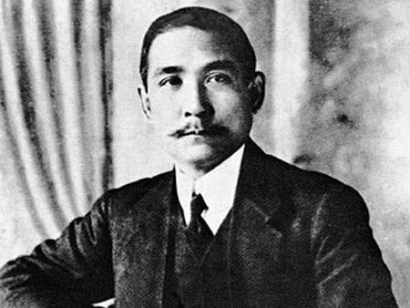
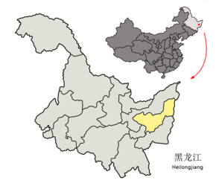
Sun Yet Seng VS. Shuang Ya Shan
Two-Duck Mountain

Slide 18

Notes:
School badge

Slide 19
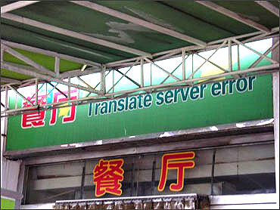

Slide 20


What we should do
Be Aware & Do check before you say

Slide 21
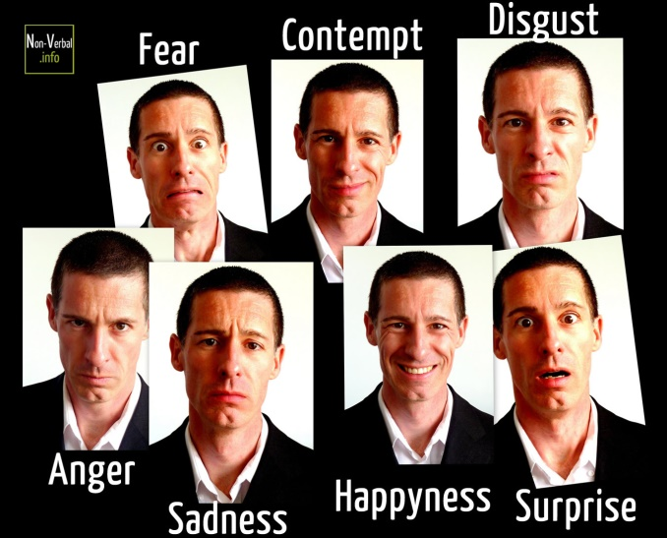
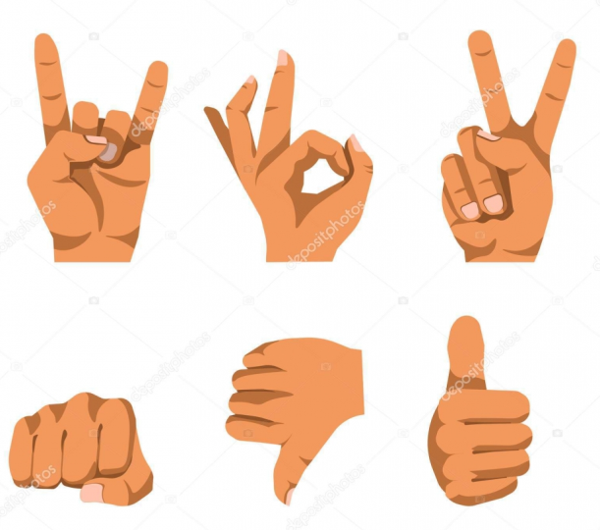
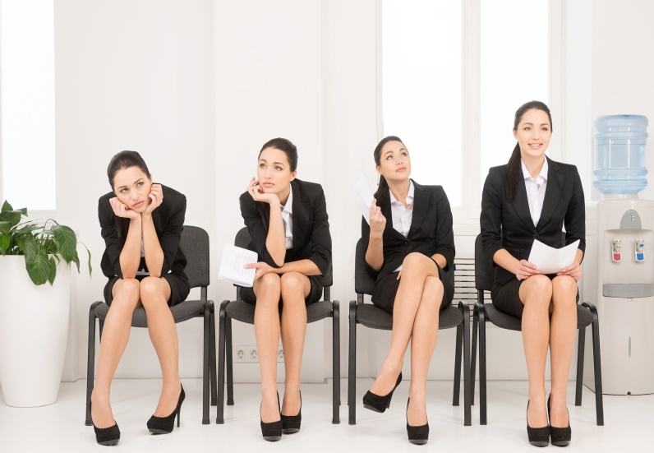
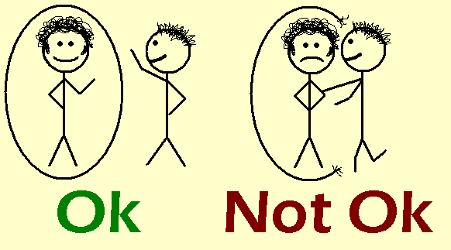
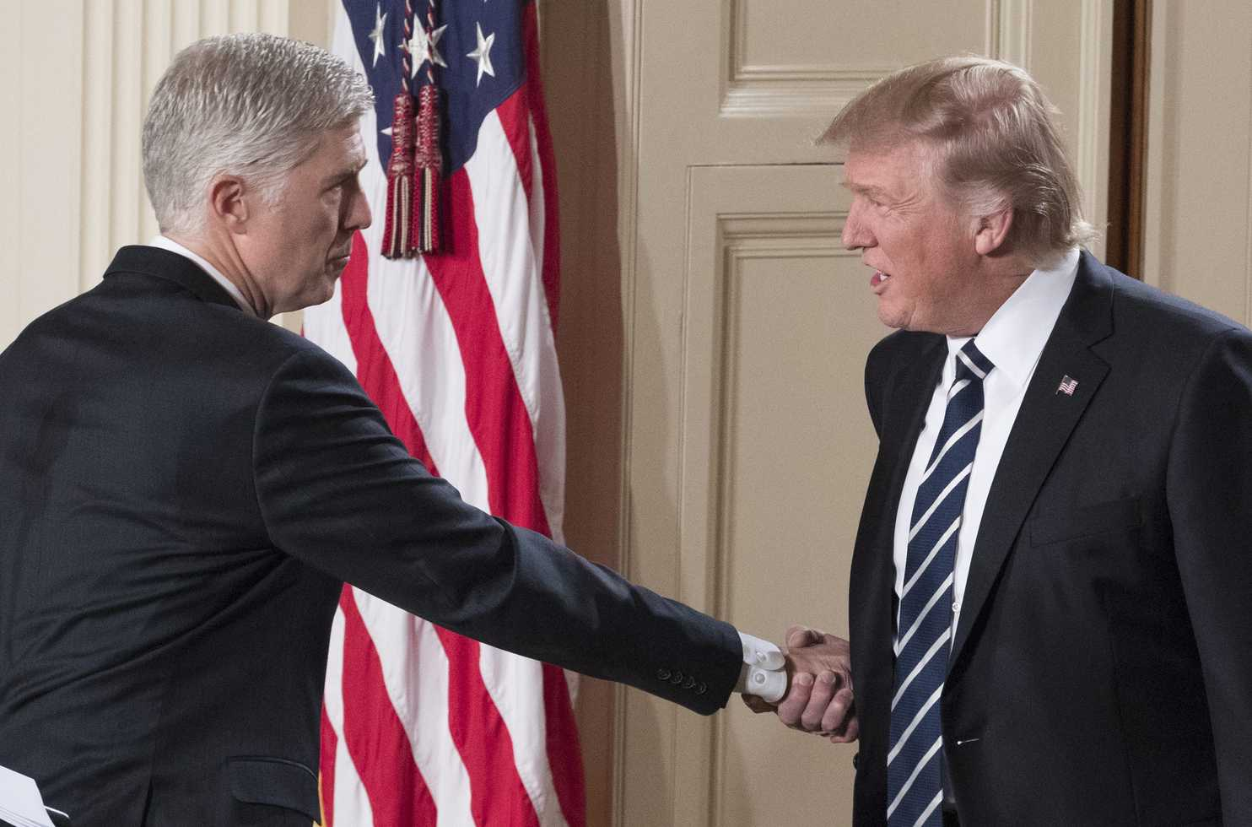
Nonverbal Communication

Slide 22
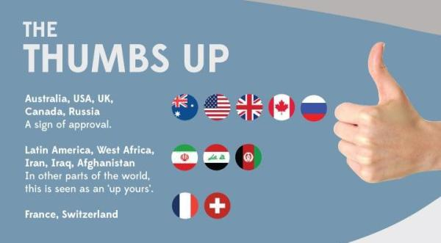
Gesture

Slide 23


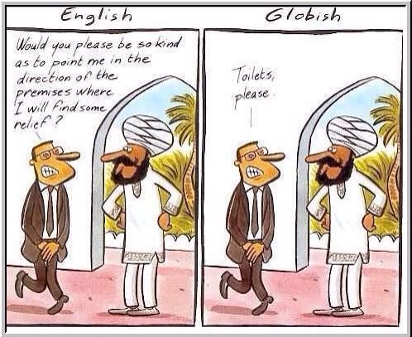
High and Low Context Cultures
Low level of directness in verbal
communication
Requires to read their
Nonverbal cues in order to
get their full message
High emphasis in
nonverbal communication
High level of directness in verbal
Communication
- Able to get most of their
full message through verbal
communication as they are
clear and direct
- Low emphasis in
nonverbal communication

Slide 24
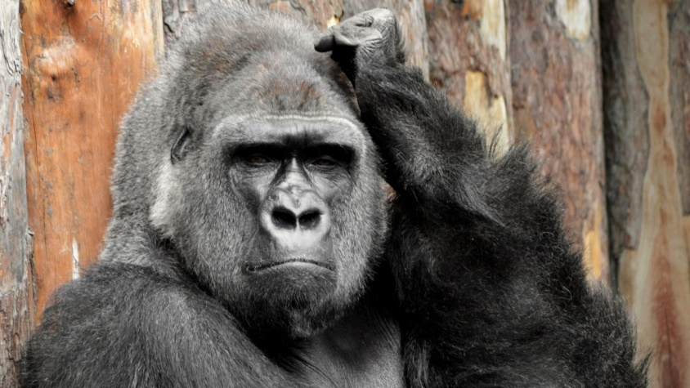
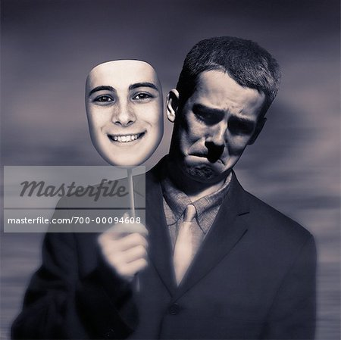
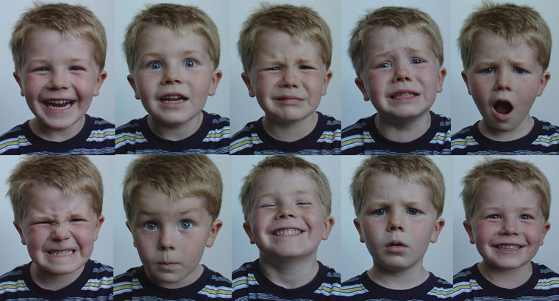
Facial Expression
Confused Gorilla: Facial expression such as smile may portray different meaning from different cultures?

Slide 25
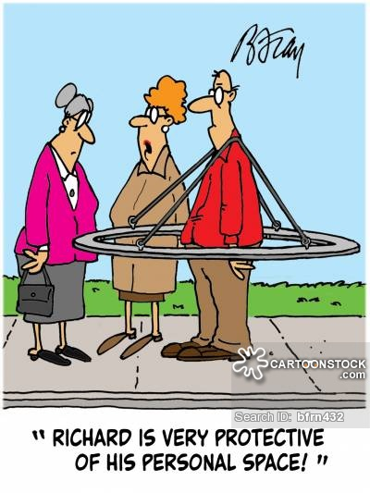
Personal Space
People from different culture require different amount of personal space, fail to understand this may create misunderstanding between intercultural communication

Slide 26

Nonverbal Communication
MAIN CONTENTS
1
Gesture
PPT模板：www.1ppt.com/moban/ PPT素材：www.1ppt.com/sucai/
PPT背景：www.1ppt.com/beijing/ PPT图表：www.1ppt.com/tubiao/
PPT下载：www.1ppt.com/xiazai/ PPT教程： www.1ppt.com/powerpoint/
资料下载：www.1ppt.com/ziliao/ 范文下载：www.1ppt.com/fanwen/
试卷下载：www.1ppt.com/shiti/ 教案下载：www.1ppt.com/jiaoan/
PPT论坛：www.1ppt.cn PPT课件：www.1ppt.com/kejian/
语文课件：www.1ppt.com/kejian/yuwen/ 数学课件：www.1ppt.com/kejian/shuxue/
英语课件：www.1ppt.com/kejian/yingyu/ 美术课件：www.1ppt.com/kejian/meishu/
科学课件：www.1ppt.com/kejian/kexue/ 物理课件：www.1ppt.com/kejian/wuli/
化学课件：www.1ppt.com/kejian/huaxue/ 生物课件：www.1ppt.com/kejian/shengwu/
地理课件：www.1ppt.com/kejian/dili/ 历史课件：www.1ppt.com/kejian/lishi/
2
High and Low Context Cultures
3
Facial Expression
4
Personal Space
Notes:
Spanish

Slide 27
Perception of Time

Slide 28
Perception of time
1
Linear
1
Linear
PPT模板：www.1ppt.com/moban/ PPT素材：www.1ppt.com/sucai/
PPT背景：www.1ppt.com/beijing/ PPT图表：www.1ppt.com/tubiao/
PPT下载：www.1ppt.com/xiazai/ PPT教程： www.1ppt.com/powerpoint/
资料下载：www.1ppt.com/ziliao/ 范文下载：www.1ppt.com/fanwen/
试卷下载：www.1ppt.com/shiti/ 教案下载：www.1ppt.com/jiaoan/
PPT论坛：www.1ppt.cn PPT课件：www.1ppt.com/kejian/
语文课件：www.1ppt.com/kejian/yuwen/ 数学课件：www.1ppt.com/kejian/shuxue/
英语课件：www.1ppt.com/kejian/yingyu/ 美术课件：www.1ppt.com/kejian/meishu/
科学课件：www.1ppt.com/kejian/kexue/ 物理课件：www.1ppt.com/kejian/wuli/
化学课件：www.1ppt.com/kejian/huaxue/ 生物课件：www.1ppt.com/kejian/shengwu/
地理课件：www.1ppt.com/kejian/dili/ 历史课件：www.1ppt.com/kejian/lishi/
2
Multi-Active
3
Cyclic
Notes:
Spanish

Slide 29

Linear vs Multi-Active vs Cyclic Time
Focus on their own task and their future ahead
Do multiple activities at the same time
We will always face the same situation again in the future
Notes:
In actual fact, the perception of time can be split into linear, multi-active and cyclic time. (*point to the diagram shown)
People who perceive linear time focus on their own task and their future ahead. For example, they follow their schedule strictly and complete one thing at a time.
People who perceive multi-active time do multiple activities at the same time. For example, people try to speak and listen at the same time. Interruptions are frequent while pauses in conversation are few.
People who perceive cyclic time believes that time will come back again and allow them to face the same situation in the future. For example, the day and night cycle regulates their lifestyle, especially on business and agriculture.
1min
**should I talk about the countries already? Or wait till next slide?

Slide 30
General perspectives to time
Case study:
America
Spain
Japan
Singapore
Notes:
Americans have a linear perspective of time. They emphasize that the past is over, present must be seized and a bright future need to be planned out. Also, to them, every second is considered investment.
Spanish have a multi-active perspective of time. They allow multiple activities to take place at a single time. Also, to them, time is always subjective and manipulated, so the amount of time spent on each activity depends strongly on their feelings in the moment.
Japanese have a cyclic perspective of time. They believe that the future will fundamentally be similar to the past. Also, to them, they care a lot about how time is divided into properness, courtesy and tradition.
However, in Singapore, due to a mix of western and eastern cultures, the perception of time really differs from people to people. So ask yourself, how do you (click) perceive time?**pause** Allow me to share with you my own perception of time as a Singaporean. I believe that time is linear. It is precious to me and to everyone else. Time can never be chased back after it has passed so I always aim to make full use of it to create a better future ahead.
1.16

Slide 31
Skit Happenings
Put a selfie of our group members
Notes:
Now take a few seconds to recall the skit we acted out previously. While the Singaporean hosted a business meeting for his 3 business partners. The Japanese arrived early, the American arrived on time while the Spanish arrived 30 minutes late. The Spanish certainly offended the Japanese and the American.
The American left on time to their next meeting without a clear conclusion of things. This certainly angered the Japanese and the Spanish.
Being the host, the Singaporean tries really hard to accommodate to each culture and ensure a smooth sailing meeting but eventually, everyone is offended by each other. Hence, it is crucial to inform them different timings to reduce possibilities of a conflict.
1min
On top of that, the Japanese actually hold a ritual before the start of the meeting and that irritated the American and the Spanish as they don’t see a point in it.

Slide 32
Uniquely Defined Actions
Planning and abiding strictly to schedules
Living freely in the moment all the time
Treasure each and every one’s time
Understanding and adaptive to all cultures
Notes:
Now you must be wondering, how does the perception of time changes things between cultures? I have singled a few uniquely defined actions by each cultureswhen dealing with time.
As the Americans meticulously plan out all their future plans and constantly make an effort to abide to their schedule. They believe that through these planning, the most sensible path into the future can be attained.
The Spanish is always lost in their control of time. They tend to live in the moment and forgo the concept of time. To them, human interactions are crucial and they are willing to sacrifice any amount of time so long as they are in the mood.
The Japanese treats time seriously. They will arrive 15-20 minutes beforehand and make a conscious effort to apologize for taking up others’ time. Ritualist expression at the start and end of each meeting is a must despite the time spent.
However each Singaporean is uniquely defined as Singapore is a place where all cultures collide and mingle together. Being immersed with different cultures, Singaporeans often act as a moderator to others.
1min

Slide 33
Individualism vs Collectivism
Individualism | Collectivism
American – everything must beneficial | Japanese – power of the mass
Spanish – competence over everything | Singaporean – cooperative with each other
Notes:
Before I end off, allow me to touch a bit more on individualism vs collectivism. Researchers have found that Western cultures tend to be more individualistic while East Asian cultures tend to be more collectivistic.
Here are a few interesting facts
In individualist culture, relationships are voluntary so American frequently end relationships when they see no benefit in them
Also in work wise, the Spanish rarely value personal attributes as technical ability or professional competence is what they need.
In collectivism, the power of the mass cannot be undermined so Japanese are slow in making decisions as they need a joint decision. I believe Singapore has a collective culture, since cooperating is the norm and everyone supports each other just like my wonder CS2101 group mates.
With that, thank you for listening to our presentation on intercultural.
**They differ in many aspects such as personal values, social, relationship, religion etc.
55seconds

Slide 34
THANK YOU
Notes:
张默然作

